Slide 1
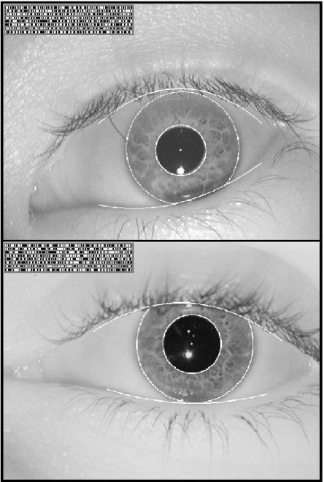
Iris
Recognition
Ben Hixon
CSCI 493.69

Slide 2
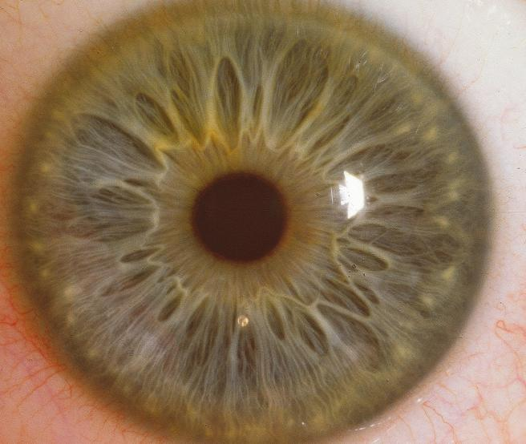
The Problem
Given a picture of an eye, we want to ask: Whose eye is this?

Slide 3
Daugman’s solution
The technique most often used today was patented in 1994 by John Daugman, and is described in his paper:
“How Iris Recognition Works.” IEEE Transactions on Circuits and Systems for Video Technology, Vol. 14, No. 1, January 2004.
I’ll be discussing his approach today.

Slide 4
Why the iris? Why not match the whole face?
Several reasons:
It’s been shown that even with great facial recognition algorithms, a face changes so much as it ages that matching between the same face that’s even just one year older can have an error rate of 43-50%. The iris doesn’t change.
The iris pattern isn’t genetic like eye color or DNA – it’s formed by random tissue tearing in the womb, so no false positives for identical twins.

Slide 5
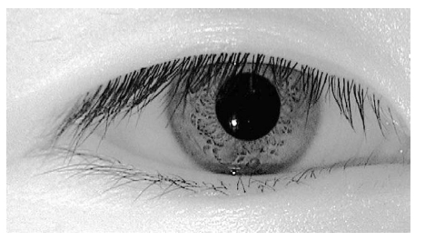
The variation in iris pattern is huge. Even dark brown eyes, which 90% of the world’s population has and which look similar under visible light, show a highly specific pattern under near-infrared light:

Slide 6
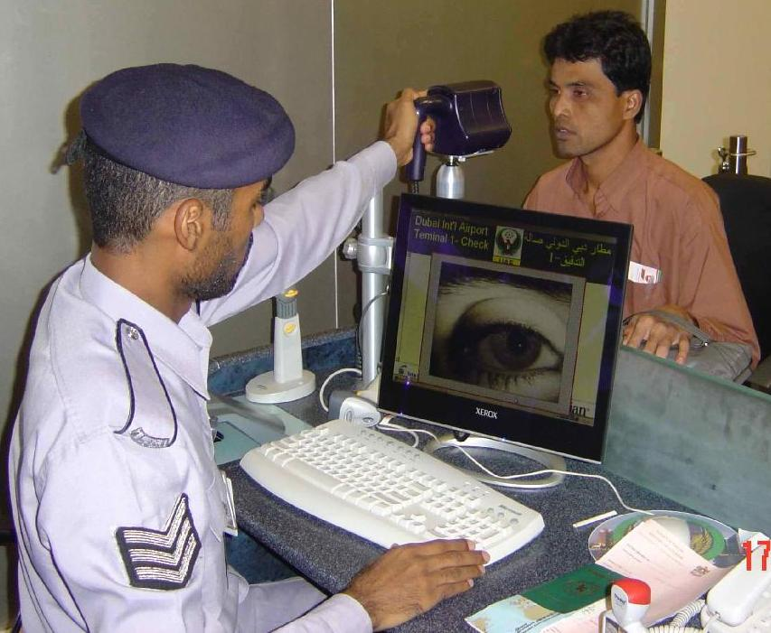
Iris recognition applications
Border security in the United Arab Emirates. (Picture taken from Daugman’s website)

Slide 7

Airport ticket recognition and security -- better than patdowns and nude x-rays?

Slide 8
Two-step Solution
The solution to deciding whose eye we’re looking at takes two steps:
(1) Iris Localization: find out where in the picture the iris is located.
(2) Matching: Somehow match (efficiently) the iris to a database of other irises with high accuracy.

Slide 9
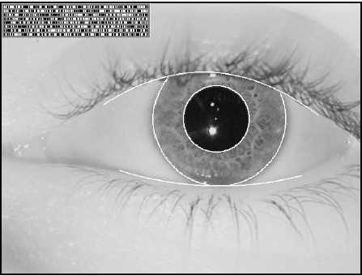
Step 1: Localizing the Iris

Slide 10
Step 1: Localizing the Iris
Finding the actual boundaries of the iris and pupil is pretty straightforward and uses techniques that we’ve seen before:
Edge detection (Daugman 2004)
Circular Hough Transform (R. Wilde)
Snakes/Active Contours (Daugman 2006)
We know how these work, but I. and II. have some downsides to consider.

Slide 11
Pros and Cons of Localization Techniques
I. Edge detection: the edge between the pupil and the iris is not sharp in dark eyes under visible light so near-infrared (NIR) light is used, but the boundary between the iris and the sclera is not sharp for light-colored eyes under NIR light. Also, eyelashes need to be considered.
II. Circular Hough transforms: the iris and especially the pupil are frequently elliptical instead of perfectly circular.

Slide 12
Step 2: Iris matching - Overview
Localization of the iris is a traditional computer vision problem using techniques we’ve seen before. But once we’ve found the iris, how do we match it efficiently against other irises?
Daugman solves this problem by (A) transforming the iris into what he calls an IrisCode (patented and trademarked), and then (B) matching it against a database of other IrisCodes by calculating the Hamming Distance between the codes. If two IrisCodes have a small Hamming Distance, they’re the same eye.
Let’s break these steps down.

Slide 13
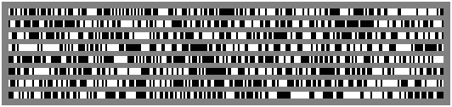
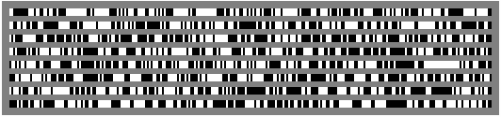
A. Iris → Bit string: Transform the iris into an IrisCode
Daugman uses a special filter called a Gabor Wavelet transform to extract a string of 2048 bits from an iris. This bitstream is called the IrisCode. 2²⁰⁴⁸ possible IrisCodes means every iris can have a unique code.
At the end of the presentation I’ll detail how he makes this transformation, but first I want to show why it’s particularly useful.

Slide 14
IrisCodes for two different irises.

Slide 15
B. Comparing IrisCodes: finding the Hamming Distance
With a database of IrisCodes, we can just search through the database looking for a matching IrisCode. Matching on a 2048-bit string is much easier than matching against an image.
But we can’t just look for identical IrisCodes. Because of slight differences in camera focus, head angle, lighting, or other noise, an IrisCode for a newly-scanned eye probably won’t have an exact match in the database, because the pictures weren’t identical.
This is why IrisCodes are particularly useful representations of irises: Daugman has shown that if two IrisCodes have a normalized Hamming Distance of less than 0.3, we can be certain with extremely high confidence that they belong to the same eye, thanks to the statistical distribution of IrisCode Hamming Distances.

Slide 16
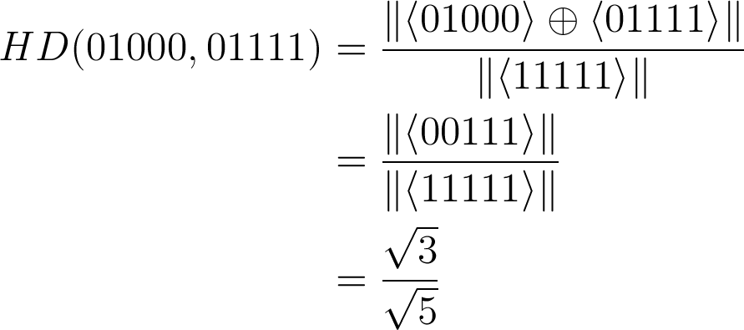
Hamming Distance: a measurement of IrisCode disagreement
The Hamming Distance between two IrisCodes (or any two strings of bits) is simply the number of bits in the two strings that are different: the Hamming Distance between 01000 and 01111 is 3.
If we divide this by the length of the string, we get a fractional Hamming Distance, eg 3/5.
The Hamming Distance can be computed very efficiently, by XOR’ing them together and taking the norm of the result:

Slide 17

Daugman further refines the Hamming distance by masking it with bit strings representing artifacts like eyelashes or glasses that are also obtained from the iris image, to make sure that the only disagreeing bits are actually iris bits instead of artifact bits. The final Hamming Distance between two IrisCodes is computed by
where the numerator represents the number of disagreeing bits that aren’t artifacts in either image, and the denominator the number of bits that are artifacts in both IrisCodes. Since the numerator is always less than the denominator, this gives a fraction between 0 and 1.

Slide 18
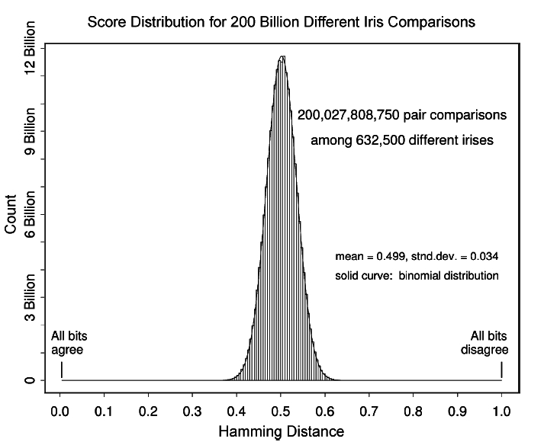
What do we do with the Hamming Distance?
Here’s a distribution of the Hamming distances found for 200 Billion iris comparisons. The smallest HD found was 0.26 and the largest was 0.75.

Slide 19
It’s extremely unlikely that IrisCodes for two different eyes will have a HD < 0.32
As we can see from the histogram, Hamming Distances for pairs of nonmatching IrisCodes are tightly concentrated around the mean of HD=0.5. The histogram follows a binomial curve with standard deviation = 0.03.
That means, if we calculate a low HD between IrisCode A and IrisCode B, it is statistically very unlikely that IrisCodes from two different irises would have produced that HD.

Slide 20
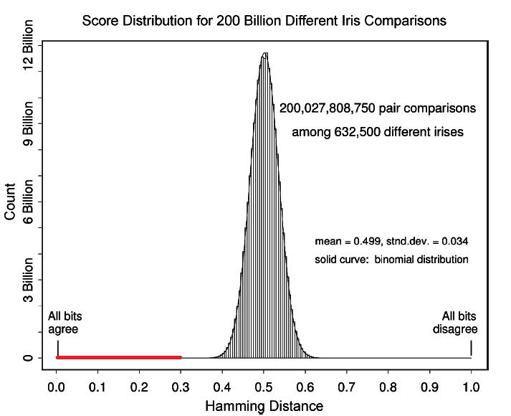
In particular, if the HD <0.3, it falls in the region underlined:
This is such a low proportion of the set of possible HD’s for different iriscodes that the chance of getting a low distance is so close to 0 that we consider the two iriscodes to belong to the same eye with high confidence.

Slide 21
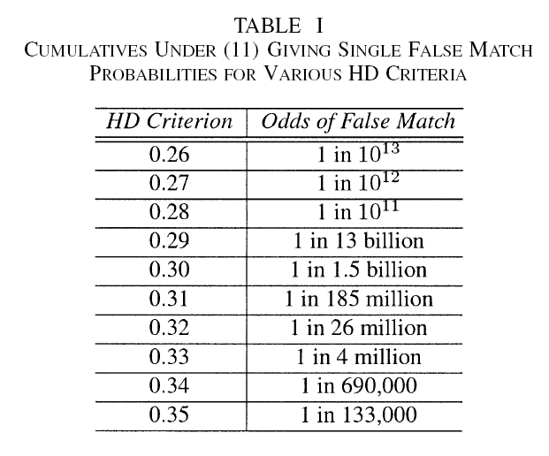
HD ≤ 0.3 : MATCH FOUND

Slide 22
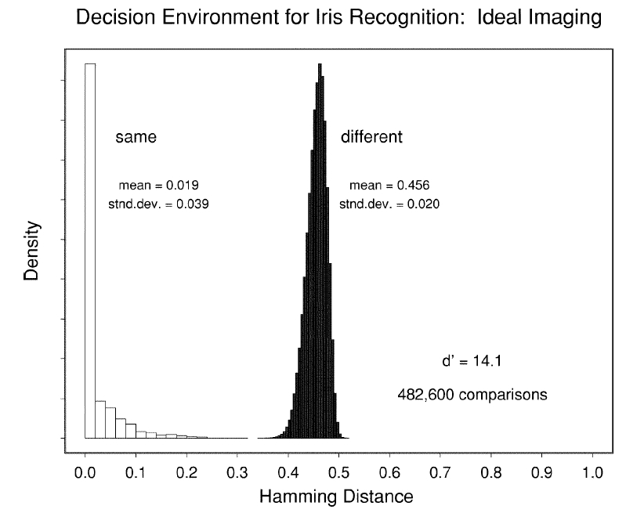
Odds of false positives and false negatives both very low:

Slide 23
So IrisCodes are useful. How do we get them?
There’s lots of ways to map an image onto a string of 2048 bits. For example, we could just start from the top-left of the region and read bits in sequentially until we get 2048 of them.
But not all mappings are equally valuable. We want a mapping that results in a useful distribution, like we’ve shown the IrisCode distribution to be.
Daugman generates his IrisCodes by sampling the Iris image in patches, and then mapping that patch to a quadrant of the complex plane with a Gabor Wavelet filter, which is a complex sinusoid function. He then takes the sign of the Real part and the Imaginary part of the result, and those are two bits in the IrisCode, 1 for positive sign and 0 for negative.

Slide 24
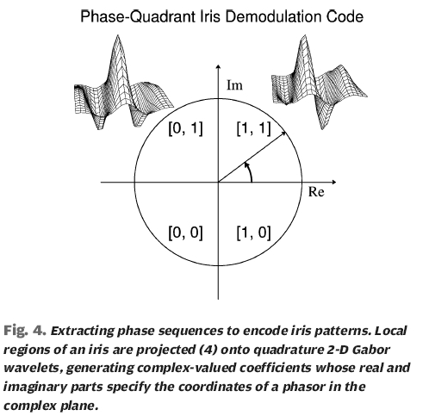
Mapping to Phasors
A “phasor” is a vector in the complex plane. By applying the Gabor transform, our output is a phasor, located in one of four quadrants. Each quadrant of the complex plane is identified by two bits, as shown.

Slide 25
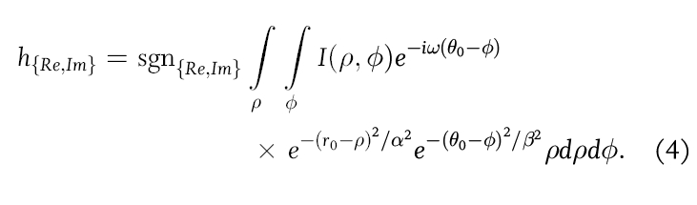
Append the phasor bits to the IrisCode
The two bits identifying which quadrant the phasor is in are appended to the IrisCode. This process is repeated until we get 2048 bits.
Here’s the actual function that he uses to get the bits:
α and β are parameters for the size of the 2d Gabor wavelet, and ω is the wavelet frequency
I is the total image, converted to polar coordinates.
Θ₀ and r₀ are image coordinates representing the “patch” of the image that is being transformed.

Slide 26
Summary of Steps
1. Start with a picture of an eye.
2. Locate the iris boundaries using edge detection, snakes, or circular Hough transform.
3. Transform the located iris region into an IrisCode (string of 2048 bits).
4. Look through database of IrisCodes, XORing until we get a Hamming Distance less than 0.3
5. If found, that’s the matching iris, otherwise the iris is not found in database (so don’t let them in the building, forbid them access to your computer, call the police, etc.)

